Slide 1
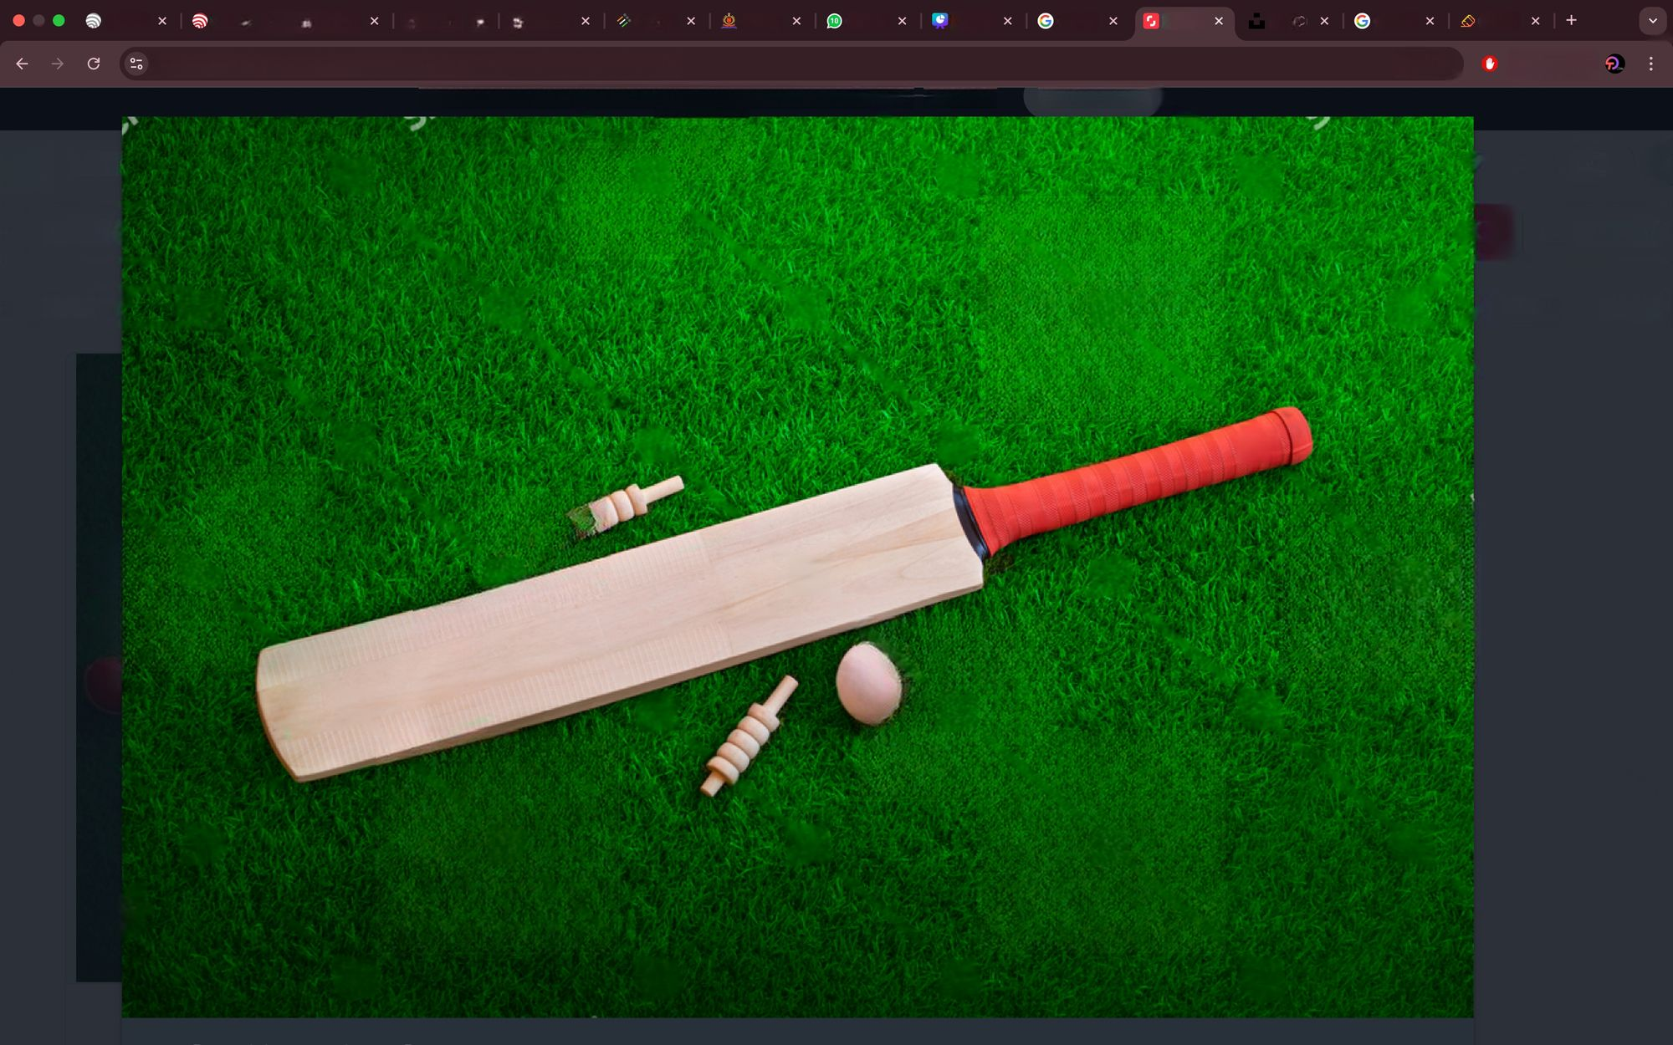

IPL AUCTION 2024 CASE STUDY
A Research Project By Shrabani Ghosh
1
CRICKET

Slide 2

Case study
Findings
Objectives
Data analysis
Table analysis
Acquisition analysis
Type of player analysis
Visual representation of type of player
Price analysis
Visual representation of price analysis
My name is Shrabani Ghosh
Contents
Contents
2

Slide 3
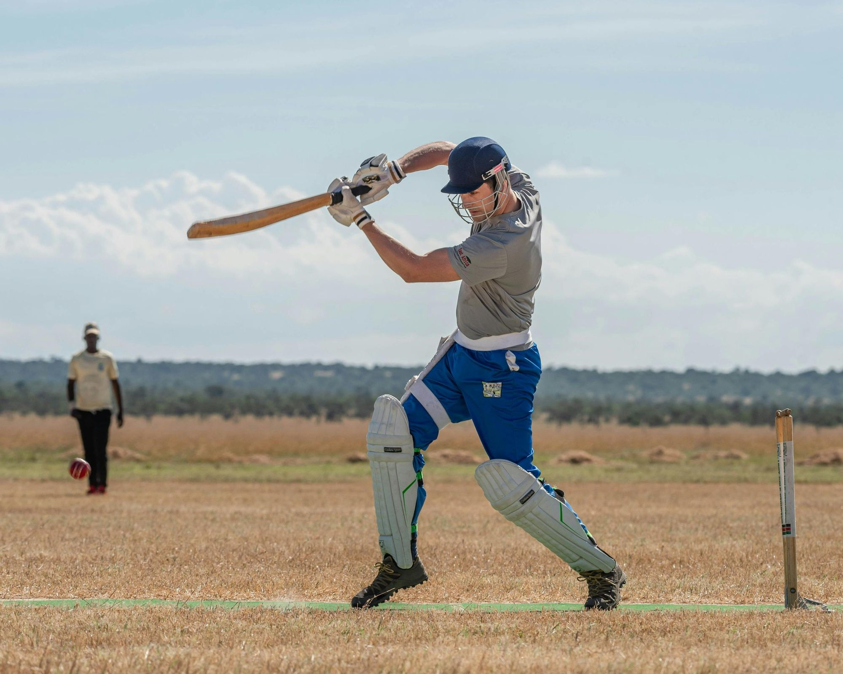

Case Study
This case study consists of 2 data sets.
The first dataset consists of auction details of all players of each team.
The second dataset contains the details of players of each team.
3

Slide 4
Findings
All 245 players were acquired, with no unsold players, indicating high demand.
RR spend the most, while DC spend the least; overseas players had a higher average price than Indian players.
All rounders were among the most expensive players; teams like RR and KKR were aggressive in bidding.
Indian players were acquired more than overseas players, but overseas players had a significantly higher average price.
Teams should balance spending on star players and budget options, focus on role-specific needs and ensure a mix of experienced and young talent for a well-rounded squad.
4

Slide 5
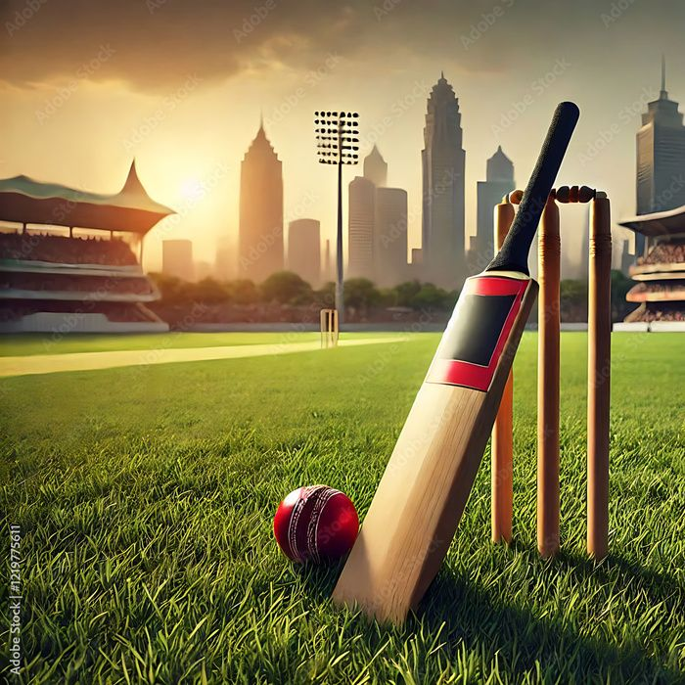
Objectives
To gain insights into player acquisitions, team distribution, roles and price trends .
5

Slide 6

Data Analysis
The number of players varies per team, with some teams retaining more players while others acquiring through auctions.
Majority of players were retained, with auctions playing a key role in team building.
Varies , with retained players typically having higher prices.
Players are classified into batters, bowlers and all rounders. Teams invest in a balanced mix.
Majority are Indian players, with overseas players mostly in high-demand roles (all rounders & bowlers).
6

Slide 7

This dataset consists of 2 tables.
This dataset consists of acquisition details of all players of each team with selling prices of the year 2024.
Table Analysis
It consists of 245 players of 10 IPL teams.
7

Slide 8
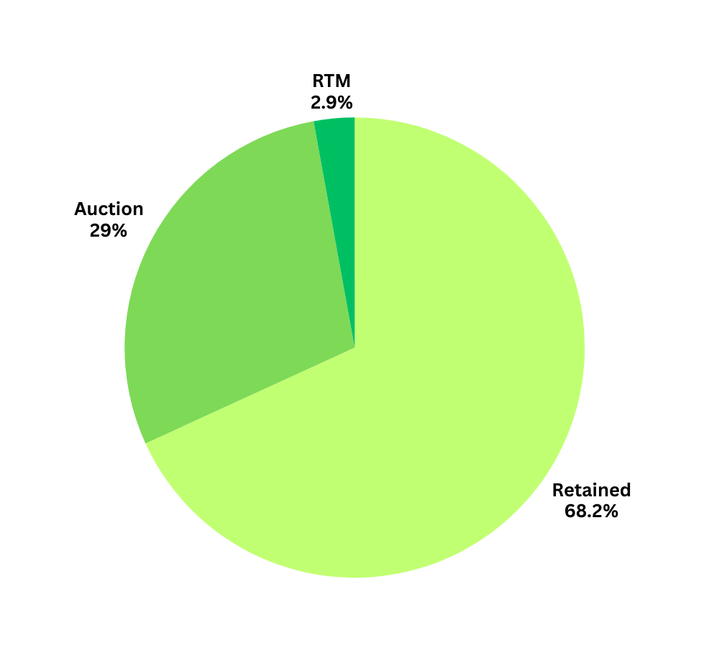
Acquisition Analysis
Total players are 245 . 167 players are retained, 71
players are auction and 7 players are RTM .
8

Slide 9
TEAMS | INDIAN | OVERSEAS
RCB | 17 | 8
KKR | 15 | 8
PK | 17 | 8
CSK | 17 | 8
DC | 17 | 8
RR | 14 | 8
MI | 17 | 8
SH | 17 | 8
LSG | 17 | 8
GT | 17 | 8
Total numbers of players = 245
Total numbers of Indian players = 165
Total numbers of Overseas players = 80
Type of player Analysis
9

Slide 10
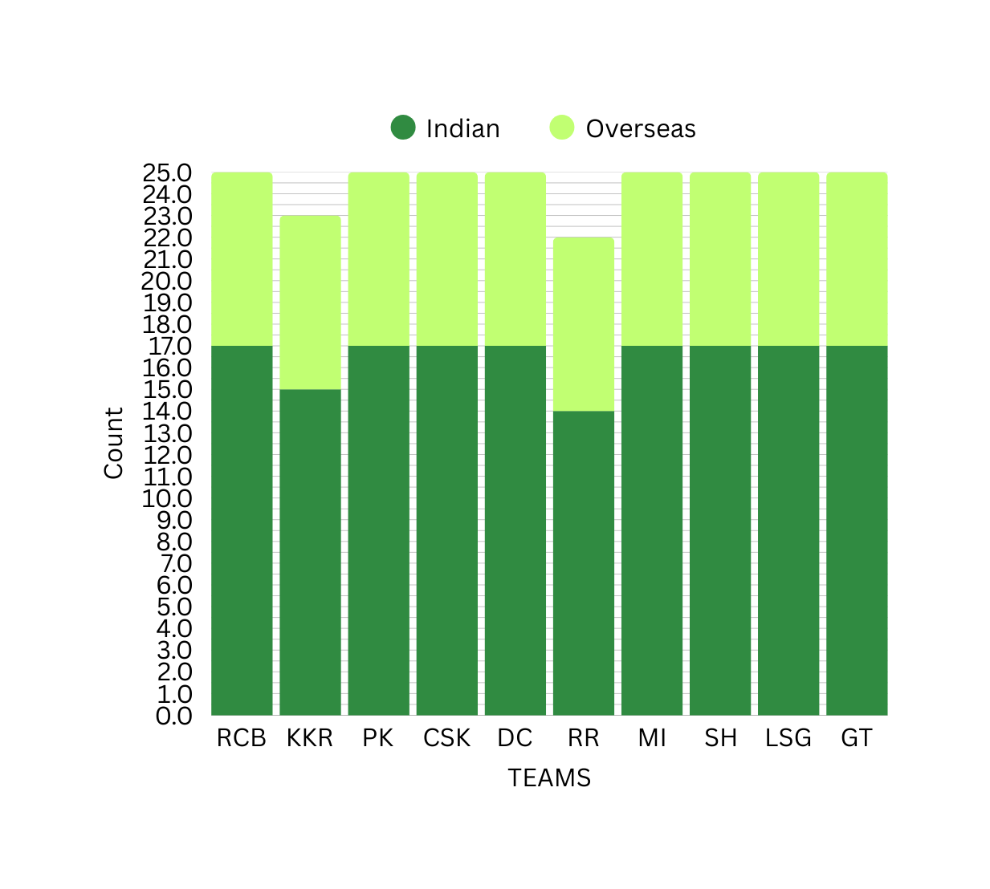
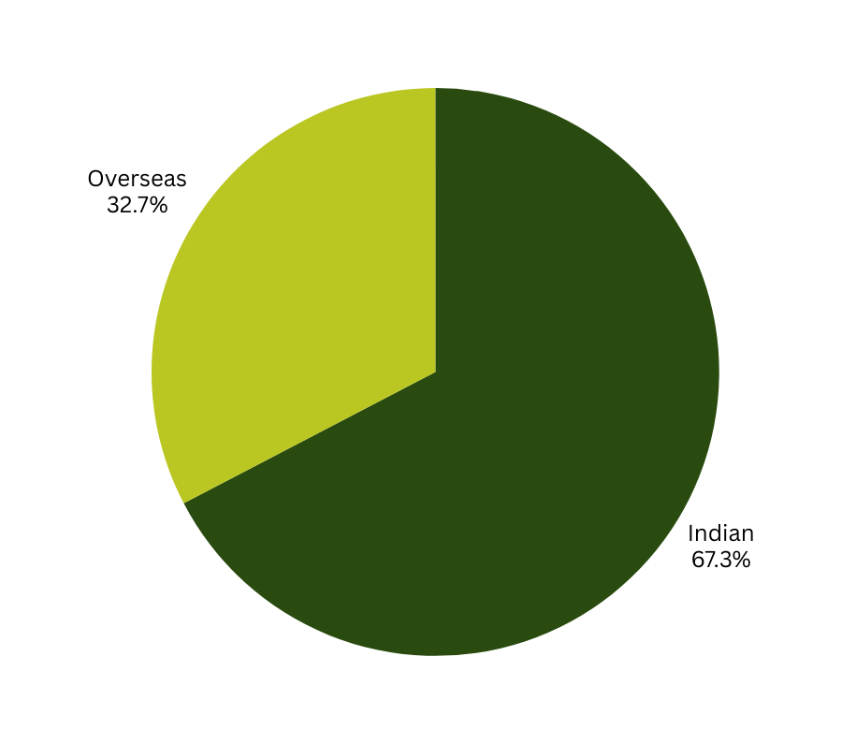
Type of player analysis
10

Slide 11

Price Analysis
Highest price paid for a player : 2475 Lakhs
Lowest price paid for a player : 20 Lakhs
Average price of players across teams :
RR - 453.64 Lakhs
KKR - 428.91 Lakhs
LSG - 396.2 Lakhs
CSK - 396 Lakhs
MI - 395.8 Lakhs
RCB - 388.6 Lakhs
SH - 387.2 Lakhs
PK - 383.4 Lakhs
GT - 368.6 Lakhs
DC - 360.4 Lakhs
Avg. price of Indian players and Overseas players are respectively 332.36 Lakhs & 523.88 Lakhs
Most expensive team : RR
Most budget-friendly team : DC
11

Slide 12
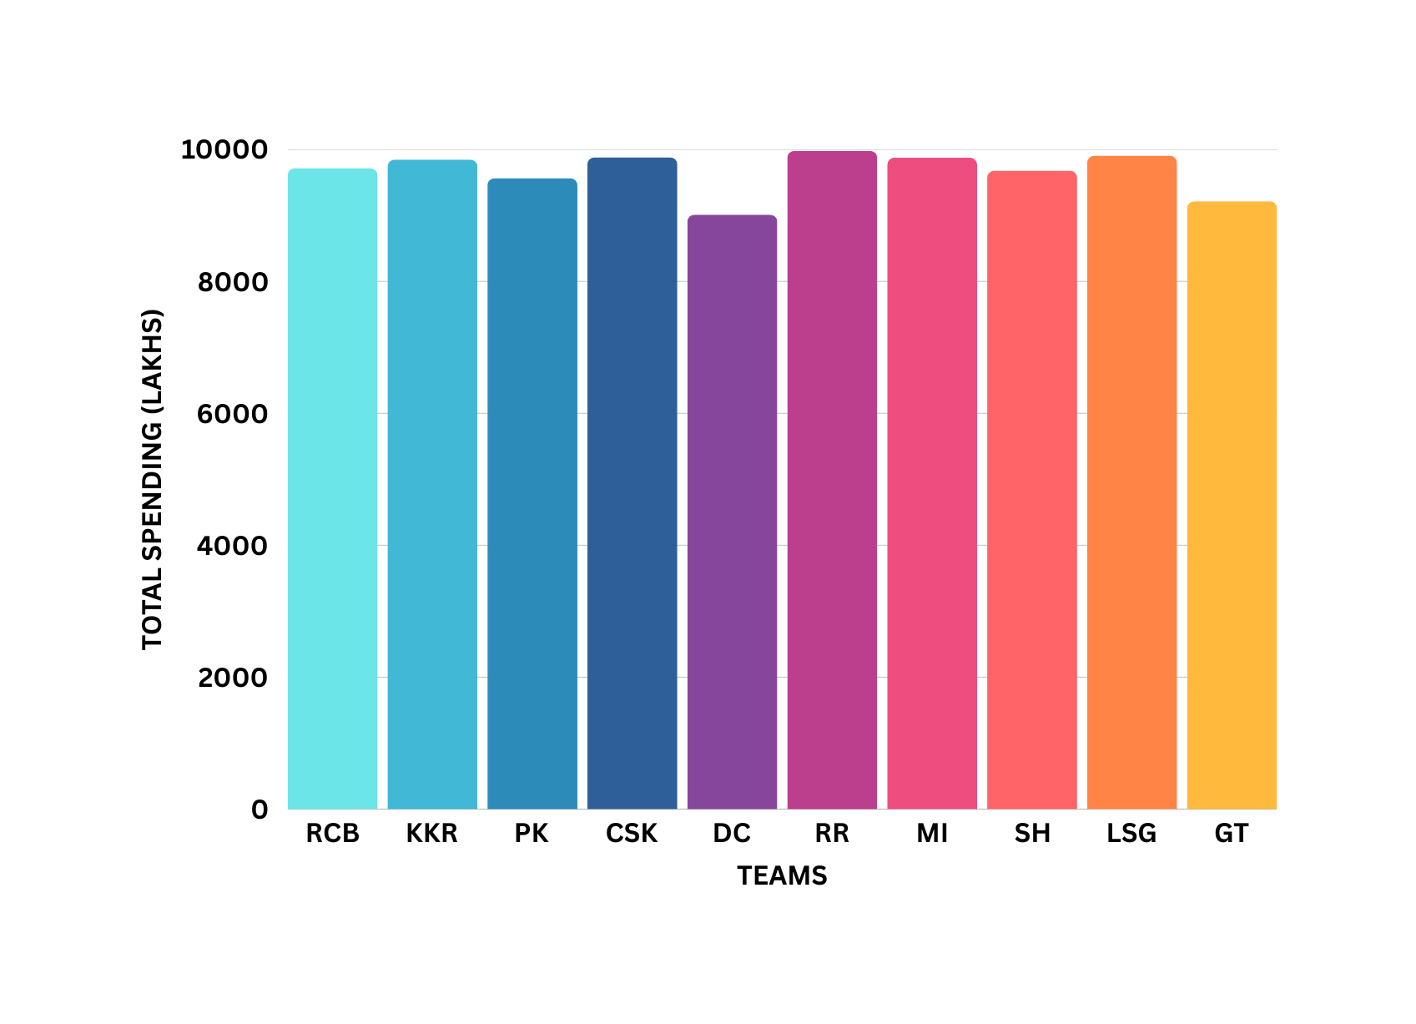
Visual representation of price analysis
12

Slide 13


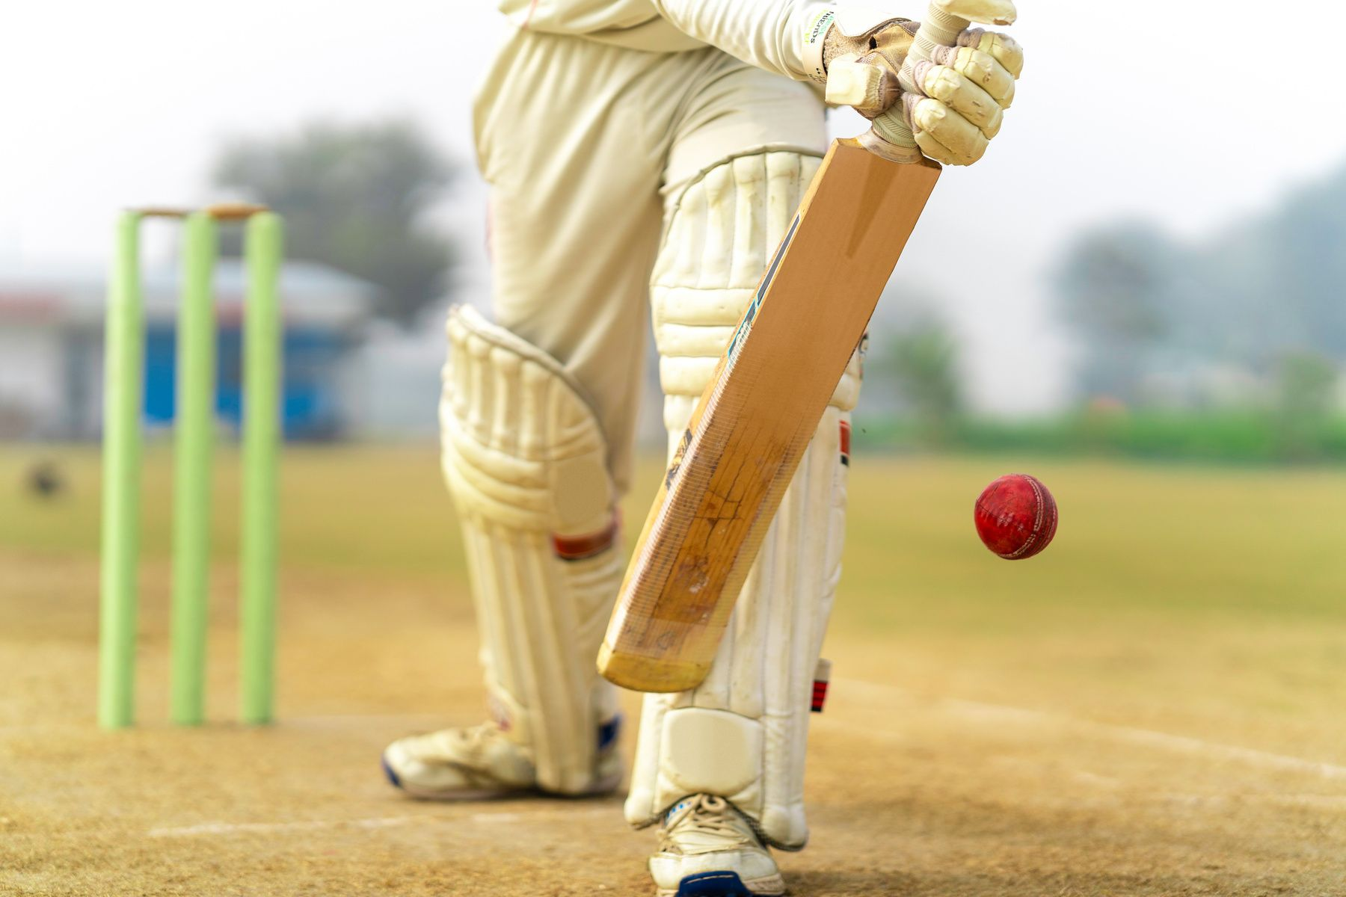
THANK YOU
13

